Slide 1

Star War Survey Data Analysis
S3815738
Wenkai LI

Slide 2
1. Data Preparation
1.2 Data Check
1.1 Data Retrieving
2. Data Exploration
2.1 How Do People Rank Episode I to VI
2.2 Hypothesis Relationships Between Columns
1.4 Find and Address the Issues
1.3 Check Missing Values
2.3 Relationships between Demography and Attitudes
2.3.1 Gender and Attitudes
2.3.2 Age and Attitudes
1.5 Data Check after Preparation

Slide 3
1. Data Preparation

Slide 4
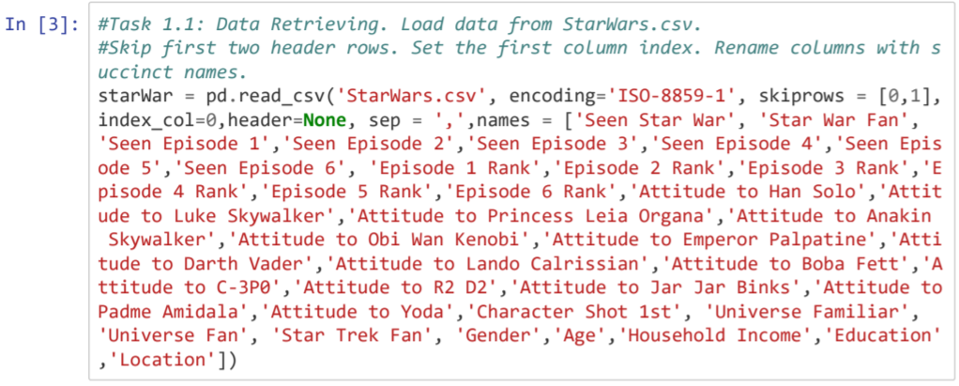
1.1 Data Retrieving

Slide 5
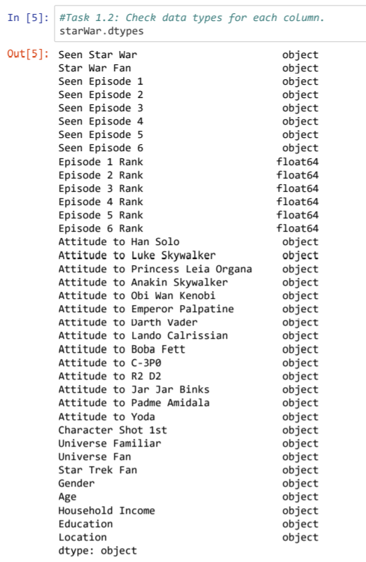
1.2 Data Check

Slide 6
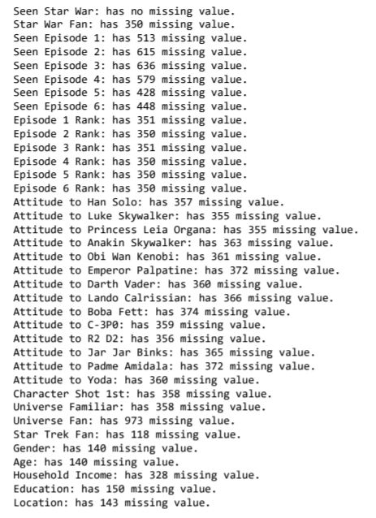
1.2.1 Check Missing Values

Slide 7
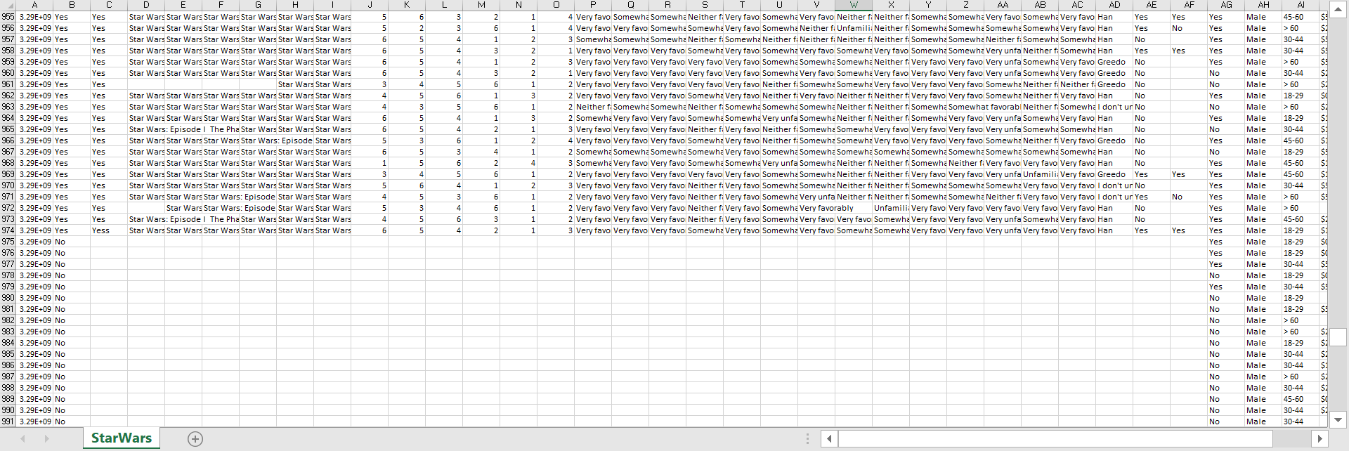
1.3.2 Check Missing Values

Slide 8
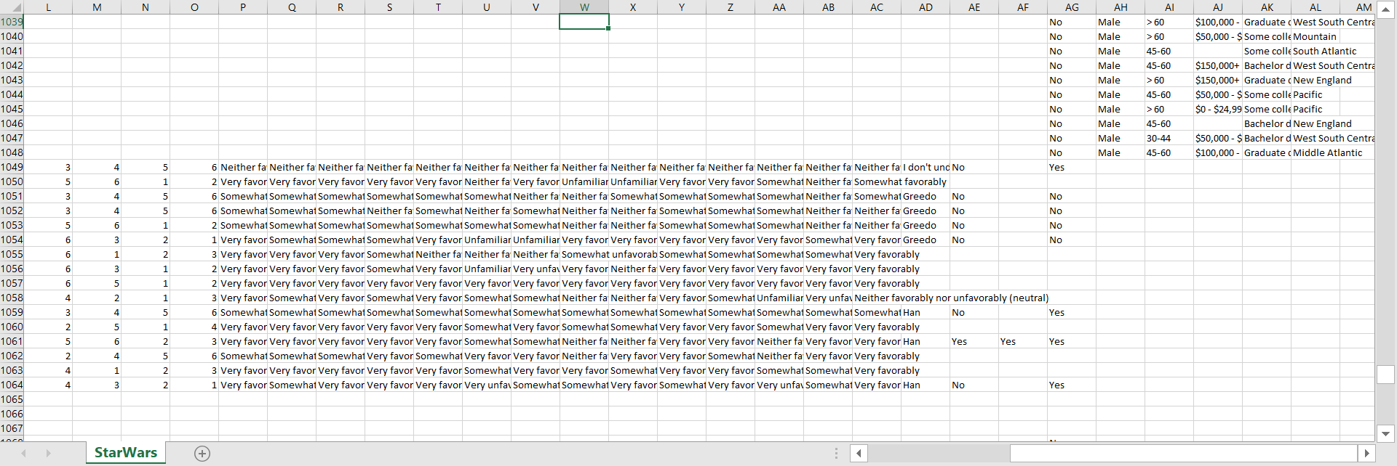
1.3.2 Check Missing Values

Slide 9
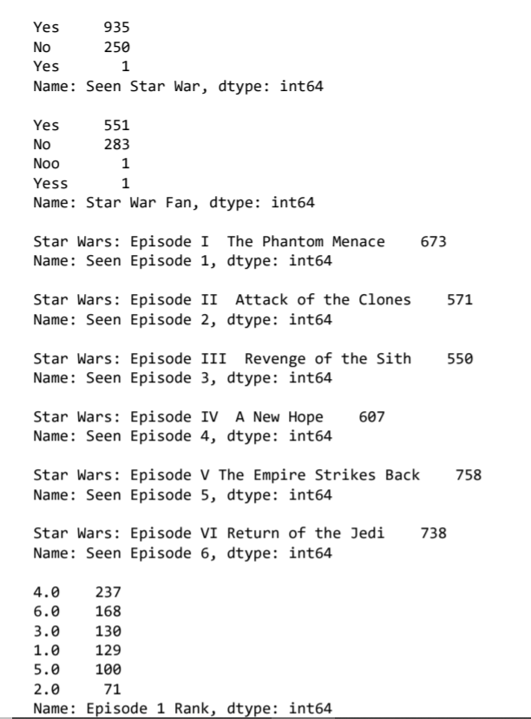
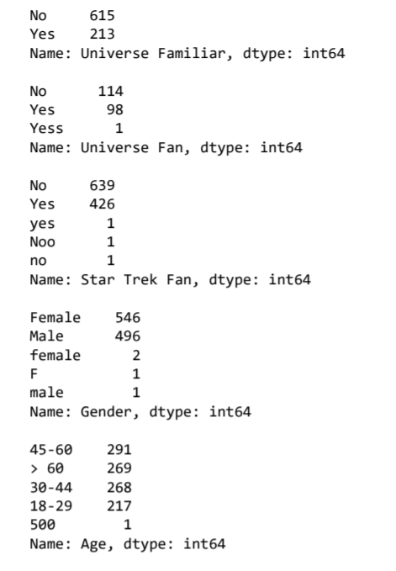
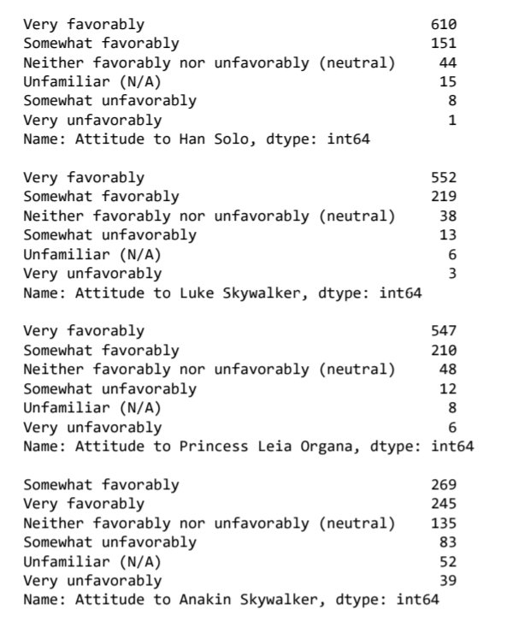
1.2.2 Find and Address the Issues

Slide 10
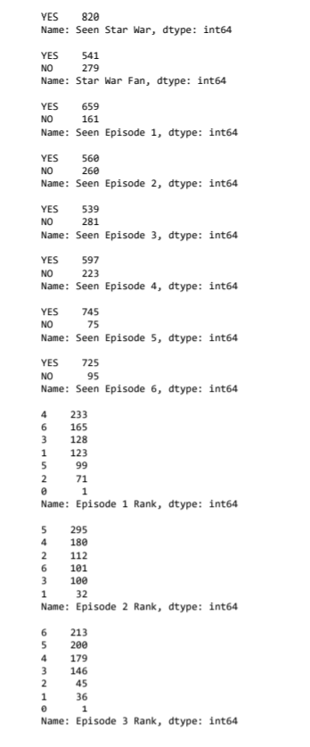
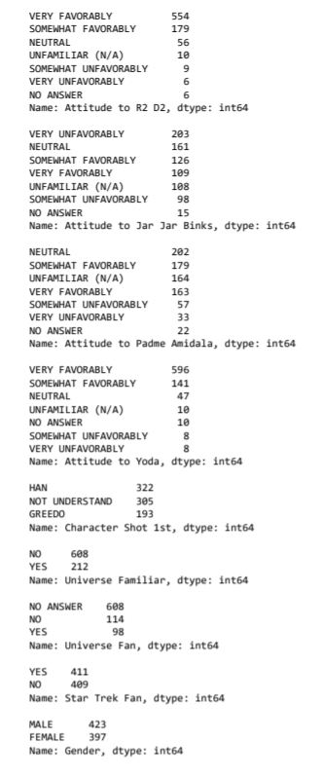
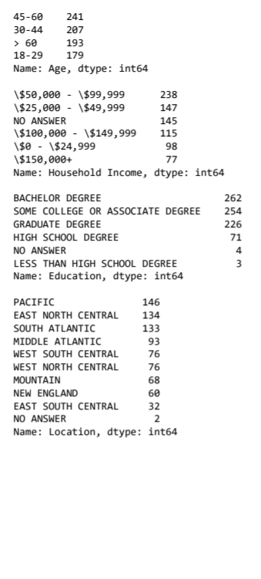
1.2.3 Data Check after Preparation

Slide 11
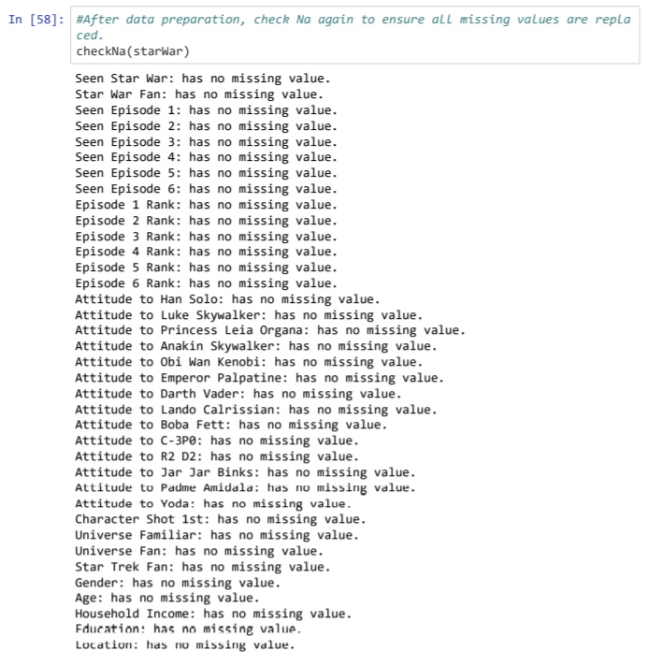
1.2 Data Check after Preparation

Slide 12
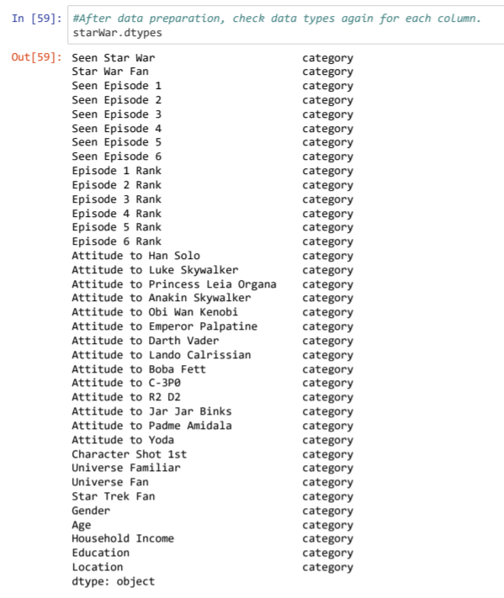
1.2 Data Check after Preparation

Slide 13
2. Data Exploration

Slide 14
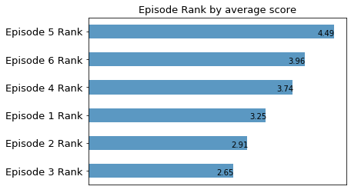
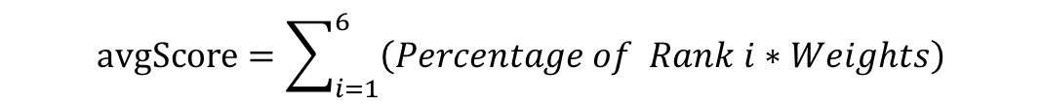
2.1 How Do People Rank Episode 1 to 6
$$avgScore=\sum_{i=1}^{6}{\left(Percentage of Rank i∗Weights\right)}$$

Slide 15
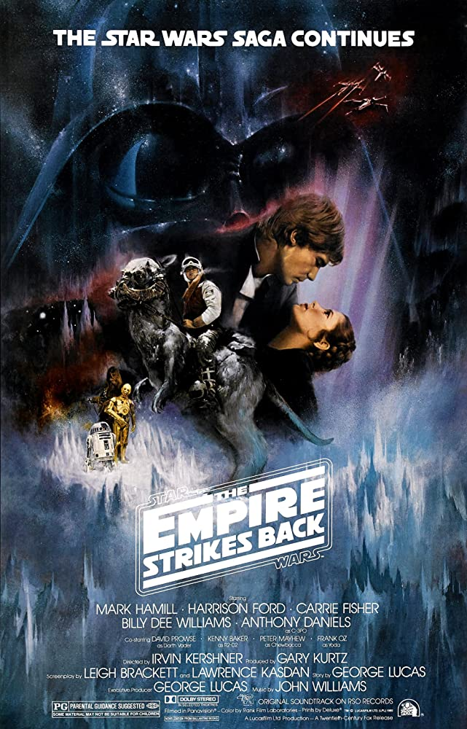
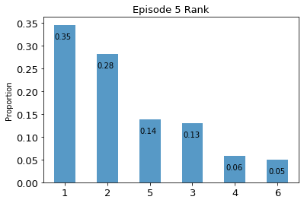
Picture downloaded from https://www.imdb.com/

Slide 16

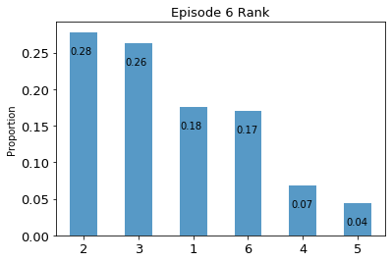
Picture downloaded from https://www.imdb.com/

Slide 17
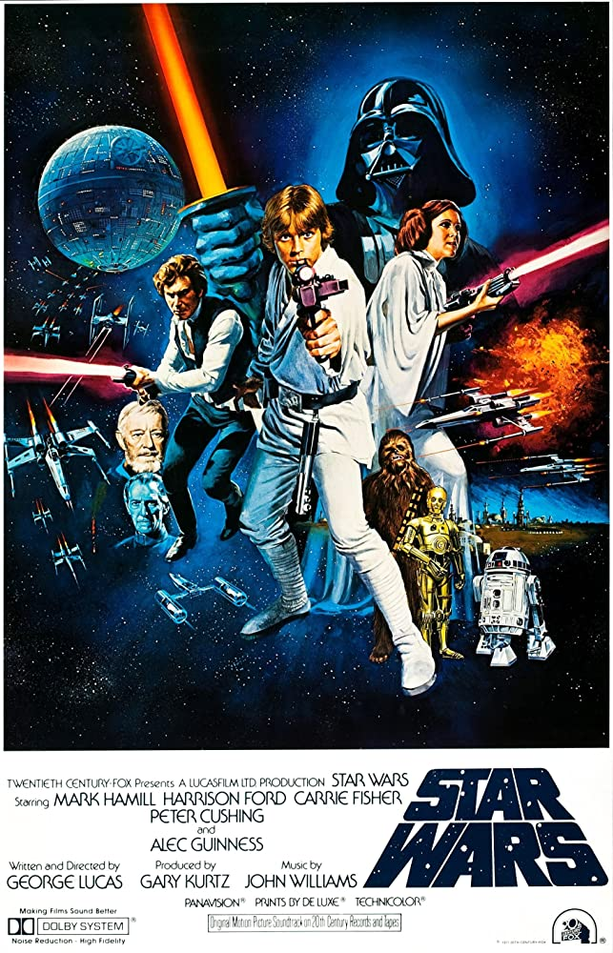
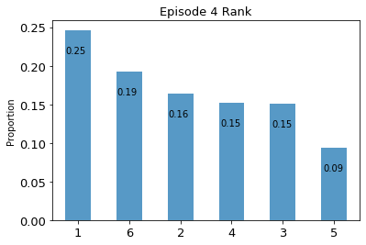
Picture downloaded from https://www.imdb.com/

Slide 18
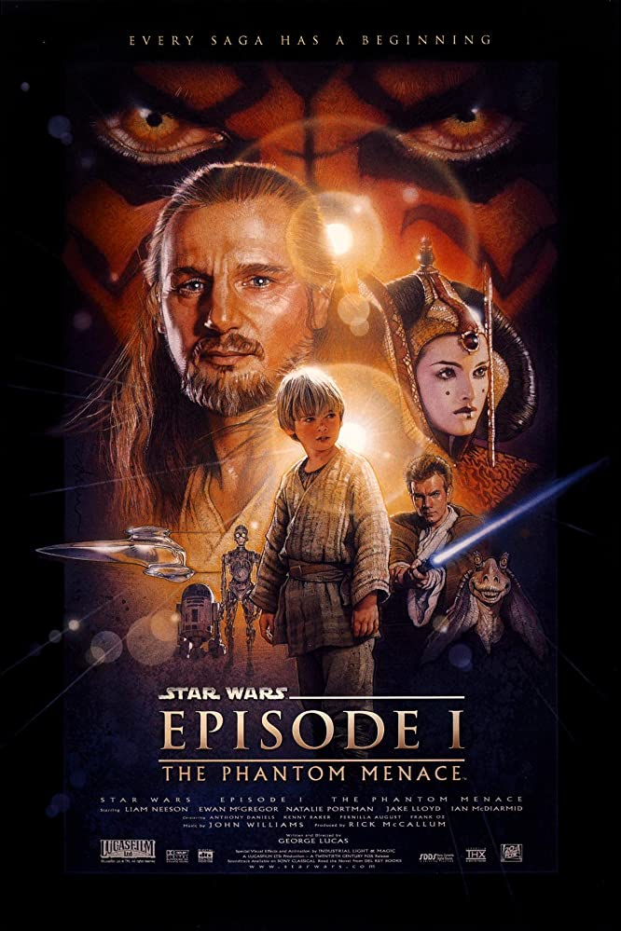
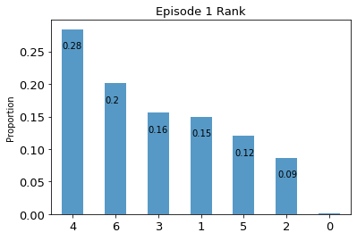
Picture downloaded from https://www.imdb.com/

Slide 19

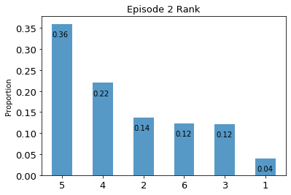
Picture downloaded from https://www.imdb.com/

Slide 20
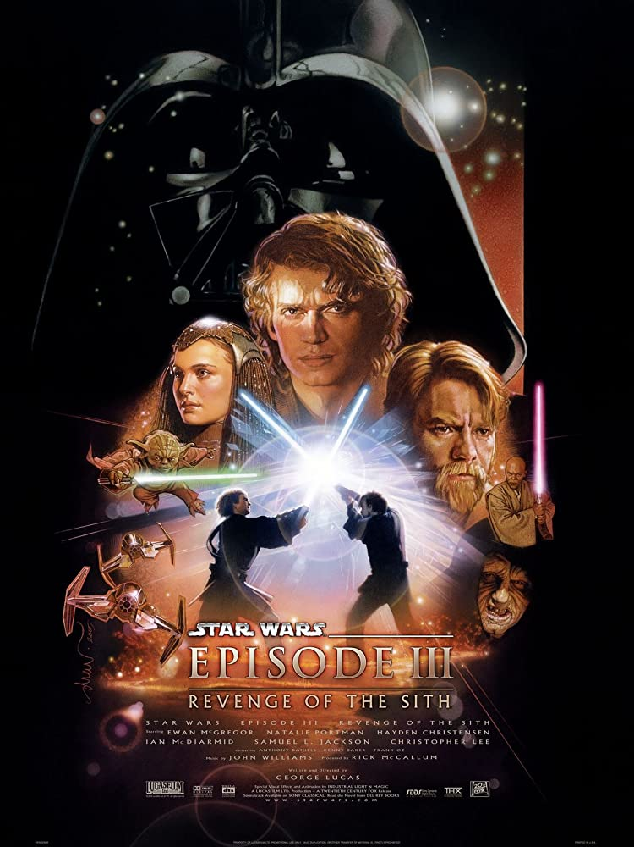
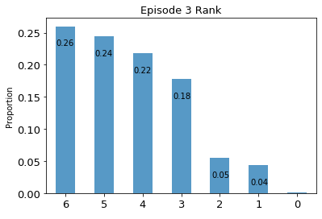
Picture downloaded from https://www.imdb.com/

Slide 21
2.2 Hypothesis Relationships Between Columns

Slide 22
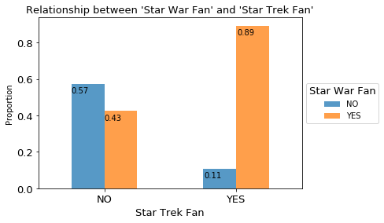
Hypothesis 1: Star Trek fans are probably also Star War fans

Slide 23
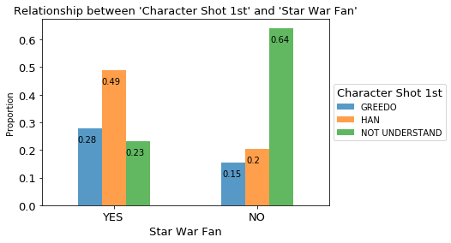
Hypothesis 2: Most Star War fans choose Han shot first while most non-fans don`t know the question

Slide 24
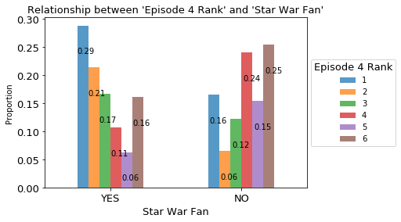
Hypothesis 3: Star War fans rank higher on Episode 4 as it is the first released episode

Slide 25
2.3 Relationships between Demography and Attitudes

Slide 26
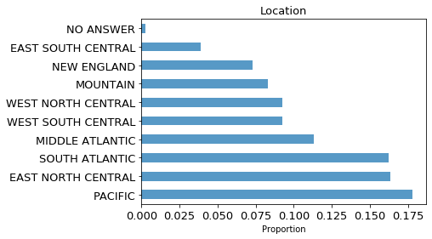
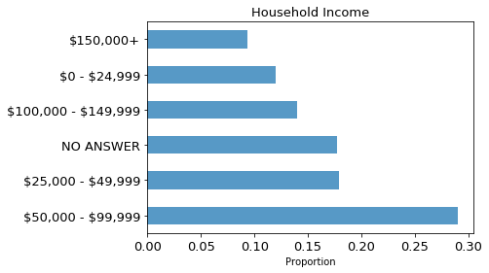
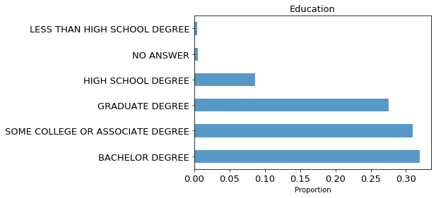

Slide 27
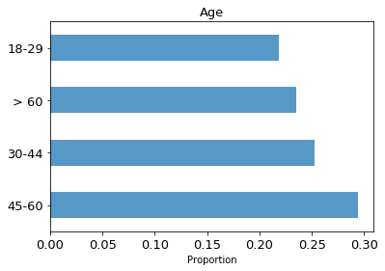
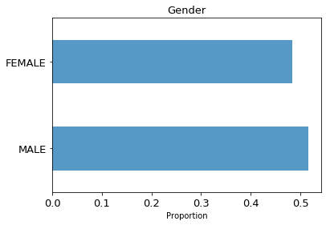

Slide 28

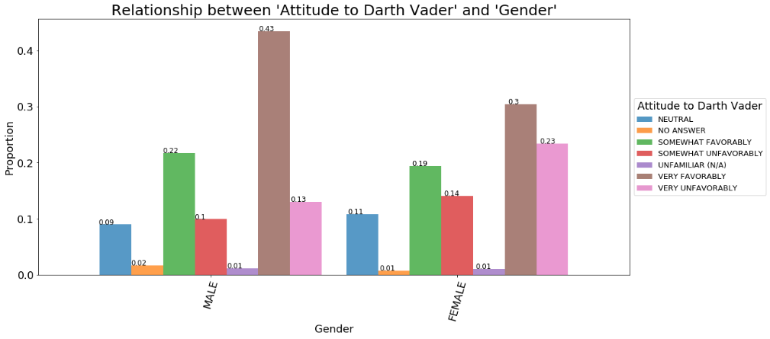
2.3.1 Gender and Attitude
Picture downloaded from https://toppng.com/

Slide 29
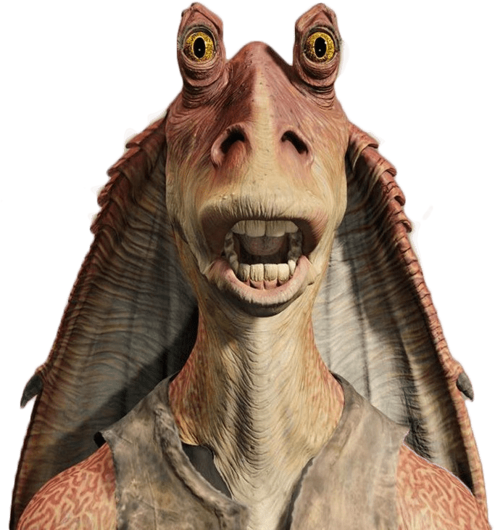
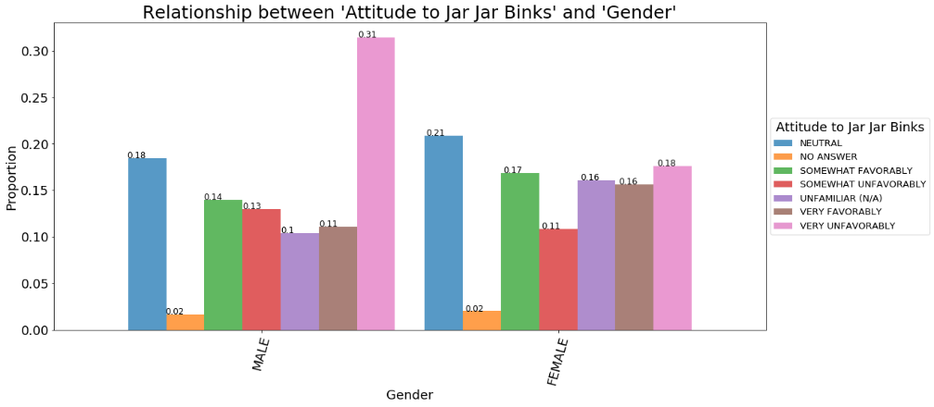
2.3.1 Gender and Attitude
Picture downloaded from https://toppng.com/

Slide 30

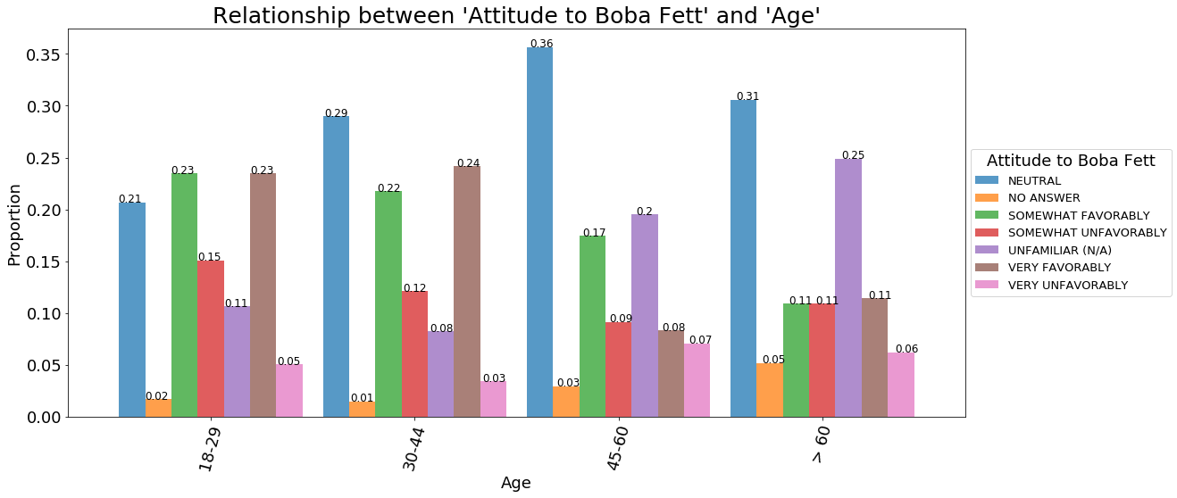
2.3.2 Age and Attitude
Picture downloaded from https://toppng.com/

Slide 31
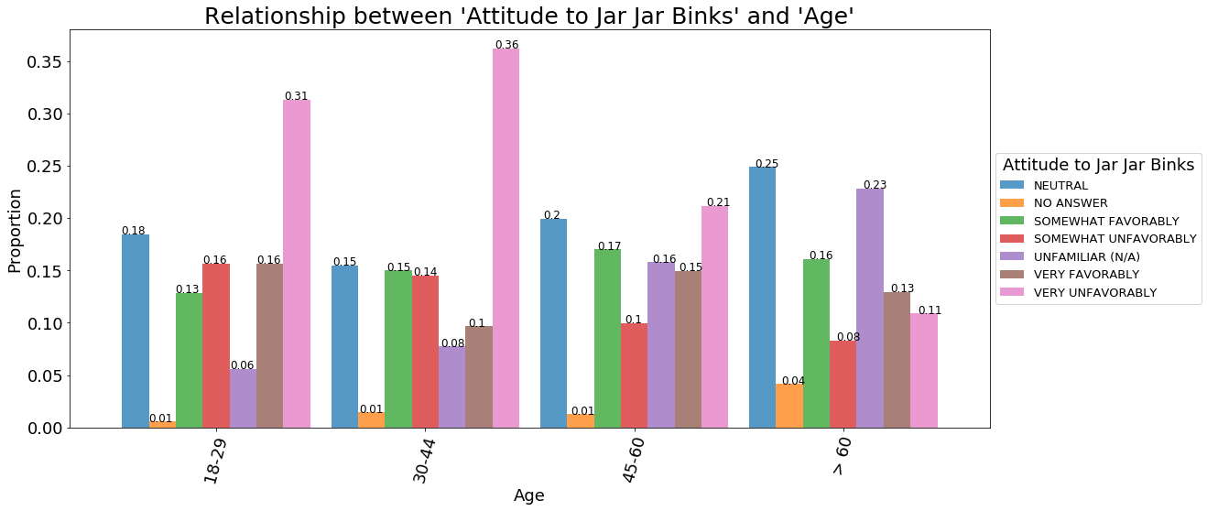
2.3.2 Age and Attitude
Picture downloaded from https://toppng.com/

Slide 32
Thanks for watching

